Slide 1

Revolutionize Posture Awareness
Let’s dive in..!
Anna Kafkoula
Stelios Lagaras
Stefania Douliaka

Slide 2
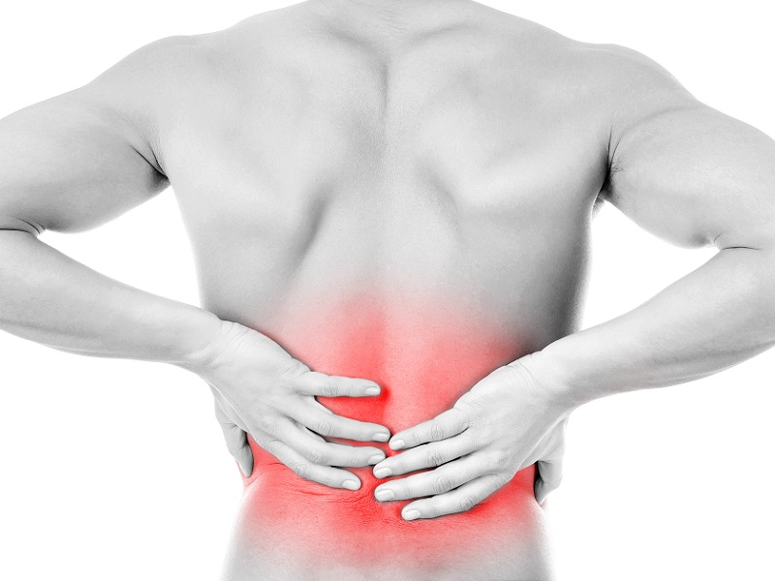
Define the Problem
100
- Modern Way of living requires many hours of sedentary life
Millions of workdays loss in U.S. per year due to Occupational low back pain (LBP)
Source: https://content.iospress.com/articles/work/wor01287
Notes:
Ο πόνος στη μέση είναι μια σύγχρονη επιδημία!
100.000 εκατομμύρια εργατοώρες χάνονται κάθε χρόνο στις Η.Π.Α.

Slide 3
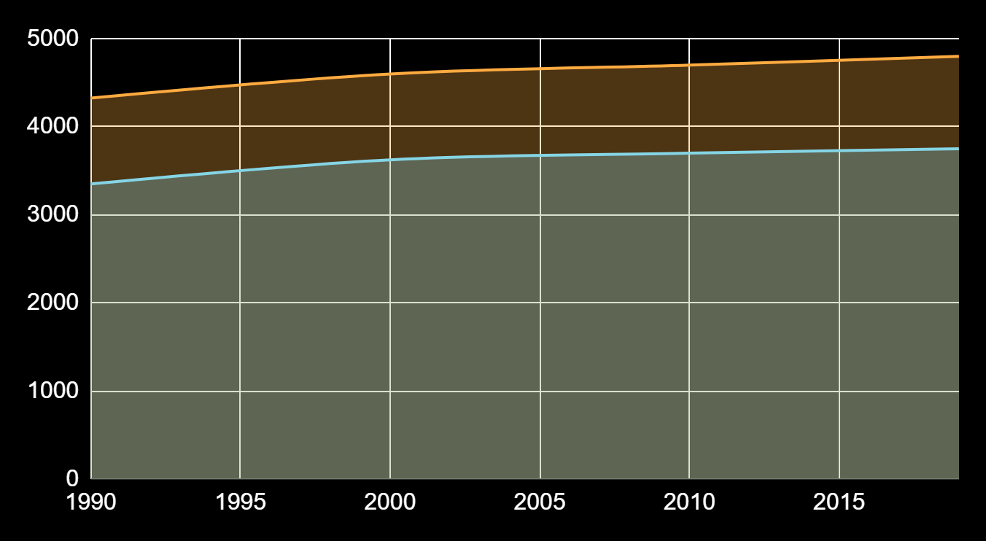
Define the Problem
Low back pain incidence in Europe, by gender | Statista
Females
Males

Slide 4
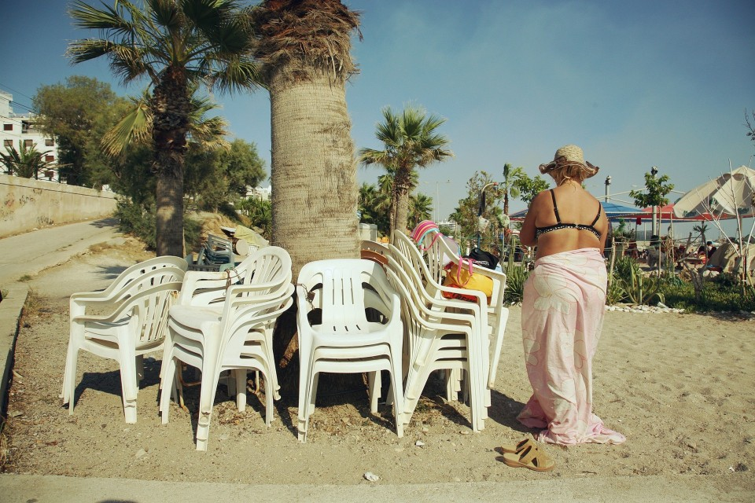
Problem Cause
Maybe it’s time to change the way we think our work chair-office
Notes:
Οι ανθρωποι μας ζουν στην καρέκλα… Είμαστε εδώ για να το αλλάξουμε αυτό

Slide 5
We are thrilled to introduce...
An Ergonomic-Smart-Pillow which provides comfort, real time posture feedback & tracking, helping individuals to increase their productivity and well-being with health experts consultation.
Notes:
I from intelligent, fidus from multifidus muscle

Slide 6
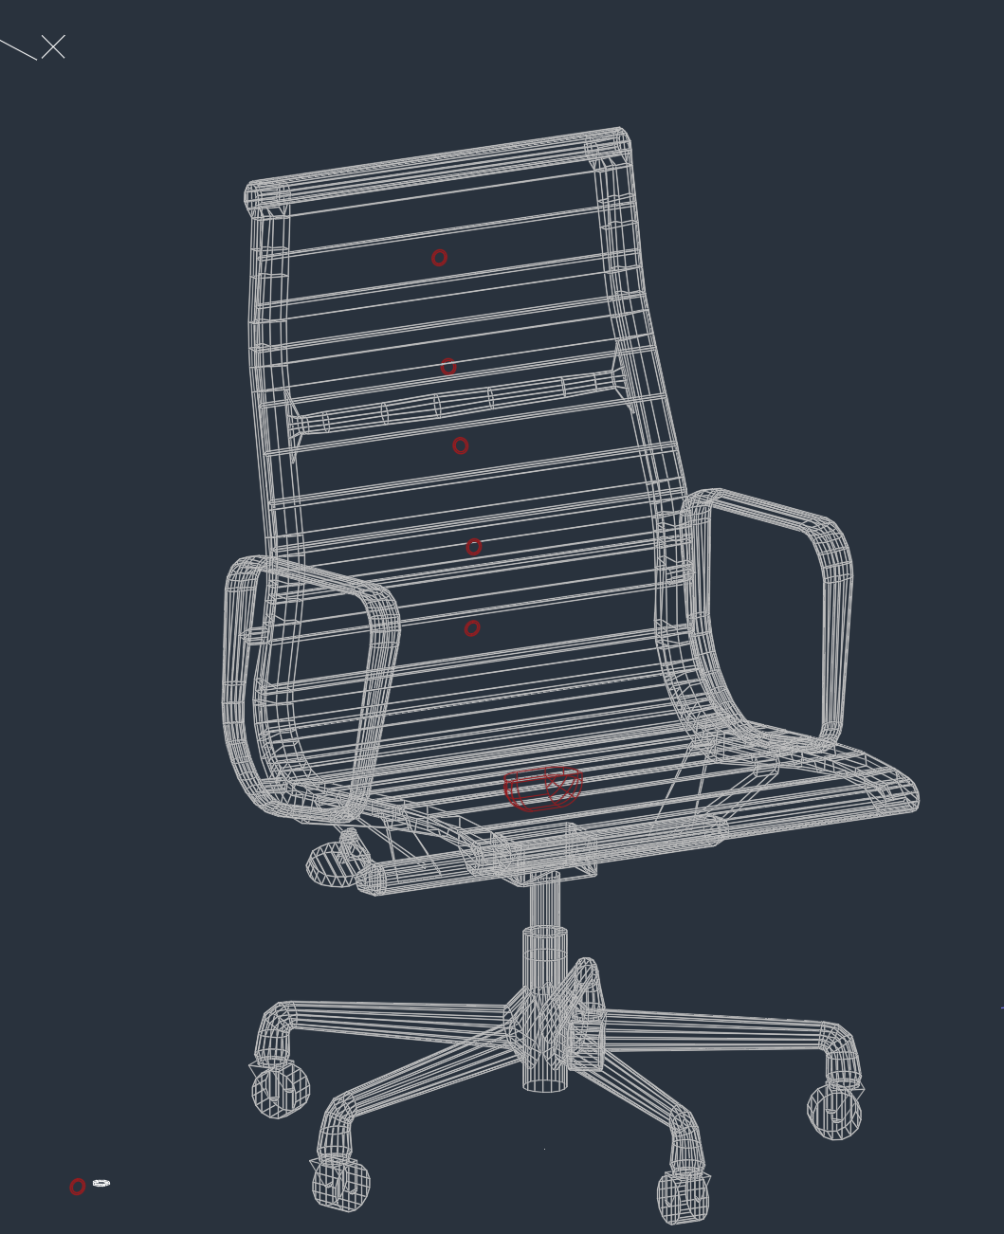
Our Solution Idea
Smart Pillow’s Features
6-8 sensors
Power bank
Sending vibration signals
Notes:
Smart pillow instead of smart chair → easy to adopt

Slide 7
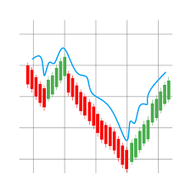

Mobile app
Connected to the app provides you:
Push notifications
(e.g. suggesting breaks, neck exercises, hydration reminder)
Collecting real time data from force sensors
Potential to share data with Health Experts (e.g. Orthopedics, Physio, Trainers)
Notes:
Data collected: pressure

Slide 8
Who will buy our product?
USER
Office workers
In a typical working week, people spend on average 5 hours and 41 minutes per day
Gamers
Freelancers
The COVID-19 pandemic has elicited increased sedentary behaviors!
CUSTOMER
B2B → Δρομέας, Plaisio & Large-Middle sized companies (e.g. NBG)
B2C → Individuals such as gamers (715 million gaming audience in Europe)
Fact: Hundreds of millions of players are engaged daily in virtual and competitive electronic gaming
Notes:
Αγορά/Market: user + customer
Ανεφερε ποσες καρεκλες υπαρχουν π.χ. Στην Αμερικη → αυτες ειναι και οι καρεκλες στις οποιες μπορουμε να ενσωματώσουμε την τεχνολογία μας (π.χ. αισθητήρες)
2 πιθανές αγορές
1η: δρομέας, skroutz → we provide them less productivity loss
2nd: B2C → reach him with affiliating marketing (15%) e.g. main influencers
E.g. Provide them with 35% discount
Γενικά ειπε οτι η αγορα μπορει αν ανοιξει πολυ π.χ. Taxi drives, pilots (steady seatings), truck drivers → εδω θα εμενα σε gamers και office workers αλλα το βλεπουμε
Σαν ωραιο line προτεινε → “Οι ανθρωποι μας ζουν στην καρεκλα”

Slide 9
Innovation & Competitive Advantage
Data Analysis and Deep Learning is an extremely “hot” aspect
A future algorithm could “recognize” patterns for Prevention!

Slide 10
Revenues and Break Even
Team
Financial Advisor
Mechanical Engineer (manufacturing & R&D)
Fundraising advisor
Computer Hardware & Software Engineer
1500 € (pro taxes) * 4= 7000 €
40.000 € (30.000 € batch products + 10.000 € certifications)
~ 150.000 € during the 1st year
Aim to Break Even: Sell about 1500 with estimated price 100€ /unit
Other Possible Revenues:
Competitions (e.g. Mindspace)
App Support (casual vs premium plan)
Data analysis on sales customers
Notes:
Business Advisor, Engineer Senior Advisor (για manufacturing % R&D), Fundraising advisor
Ειμαστε 4 ατομα, 1200 euros each (μικτα) → 5000 euros per month for 4 people
40.000 euros for πιστοποιησεις και production (10.000 σε πιστοποιησεις+30.000 batch products)
Για ενα χρονο θελουμε 100.000 ευρω
5.000 για 12 μηνες= 60.0000
60.000+40.000=100.000 ευρω
Για να κανουμε αυτα τα χρηματα του 1ου χρονου break even (εσοδα=εξοδα) θελουμε να πουλησουμε πανω απο 1000 συσκευες με περιπου 150 ευρω (κοστος) την συκευη (50 ευρω production για να εχουμε 100 ευρω κερδος each), low volume production

Slide 11
Milestones
6 Months
12 Months
13-14 months
Low production
Pilot testing with real customers
1st B2B sale
(e.g. 50 units)
Notes:
6 months -prototyping test → pilot testing με real customers → αυτος θα ειναι και 1ος costumer μας και training πελατη στην συσκευη
6 months-ετοιμη παραγωγη
13-14ο months→ 1η B2B πωληση, expected 50 κομμάτια

Slide 12
Our Moto
We got your … Back!
Special thanks to:
Mentors and Facilitators Yeoryios Staboulis & George Megas
Architects Danai Makri & Vaitsa Makresia
Co-Founder Aid-Plex Dimitris Moustakas

Slide 13
CONTACT
Do you have any questions?
akaukoul@gmail.com
stelioslagaras@gmail.com
sdouliaka@gmail.com

